Slide 1
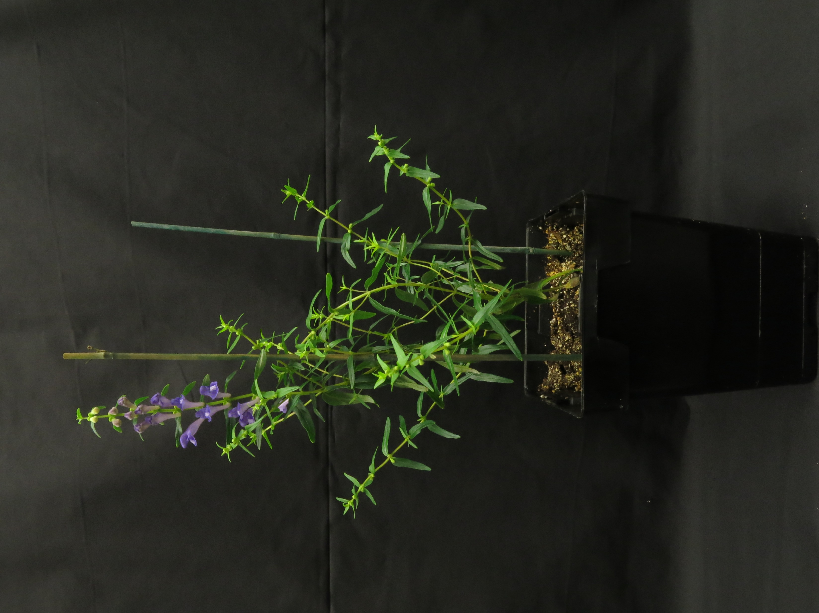
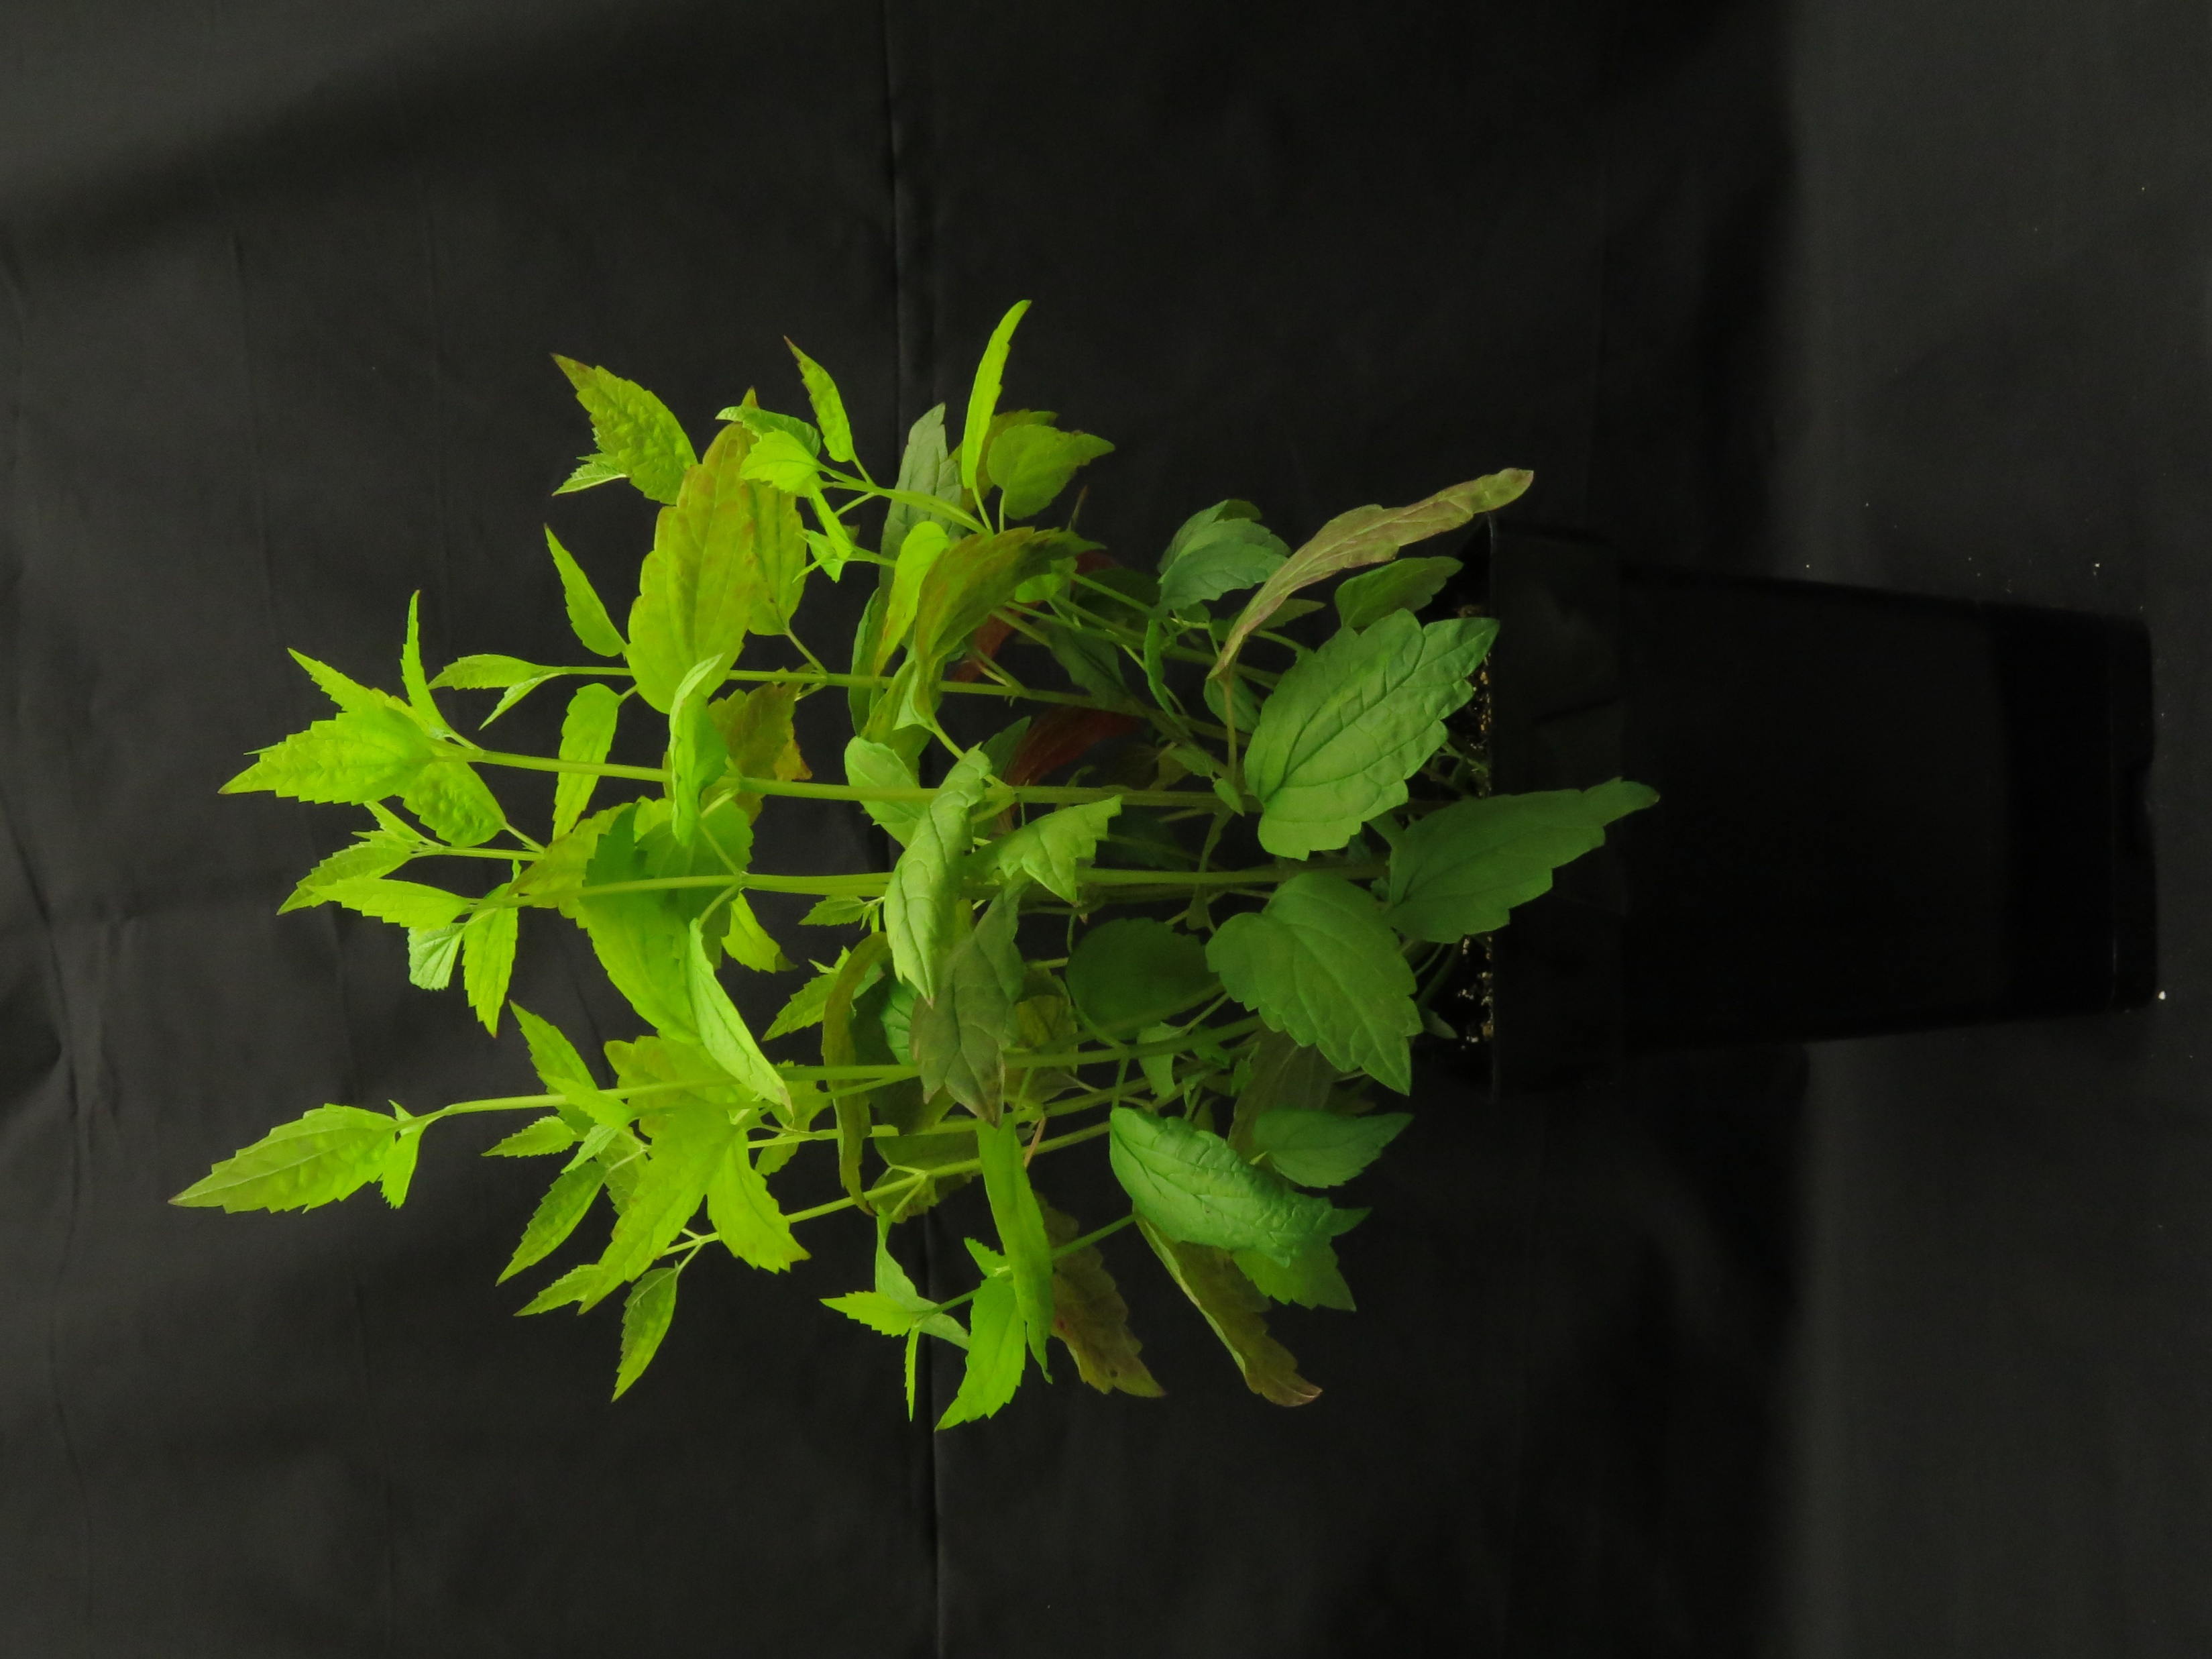
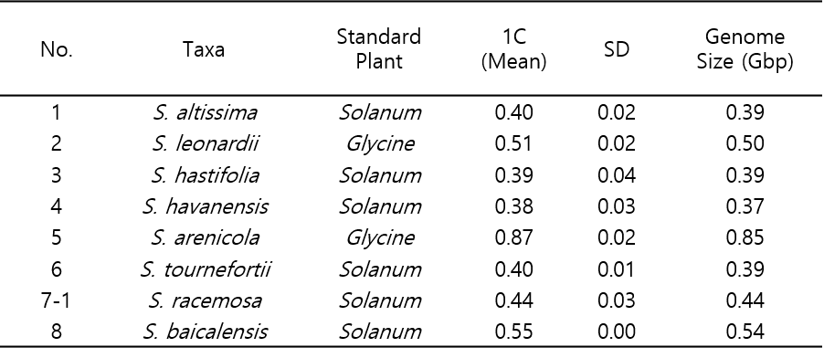
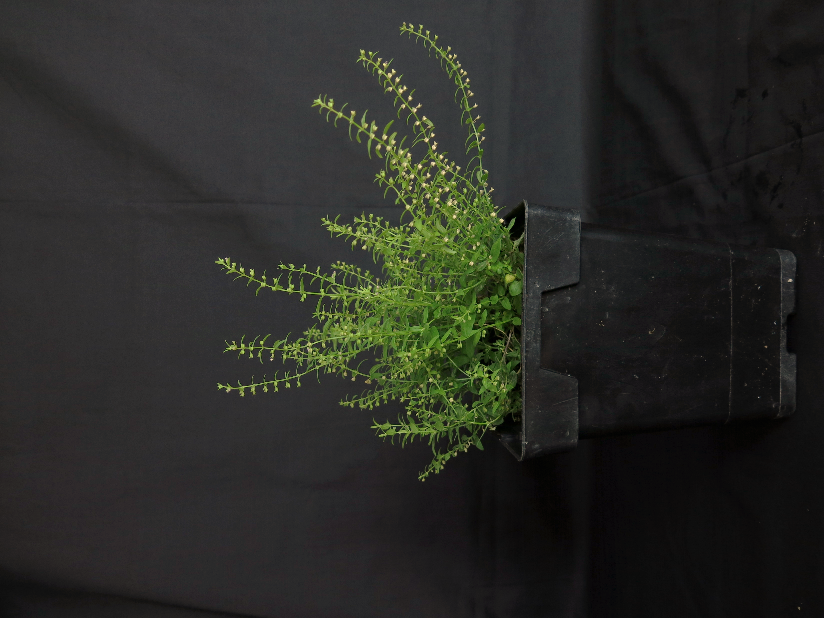
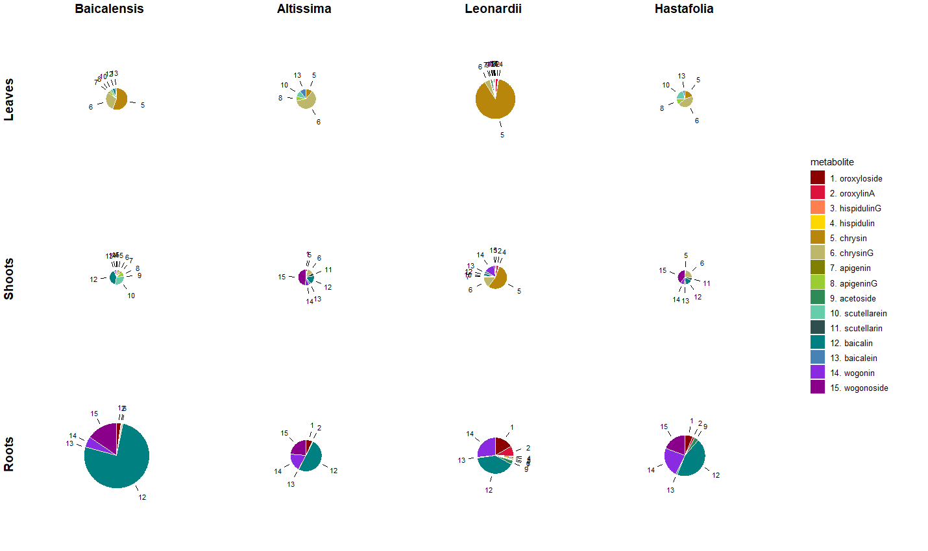
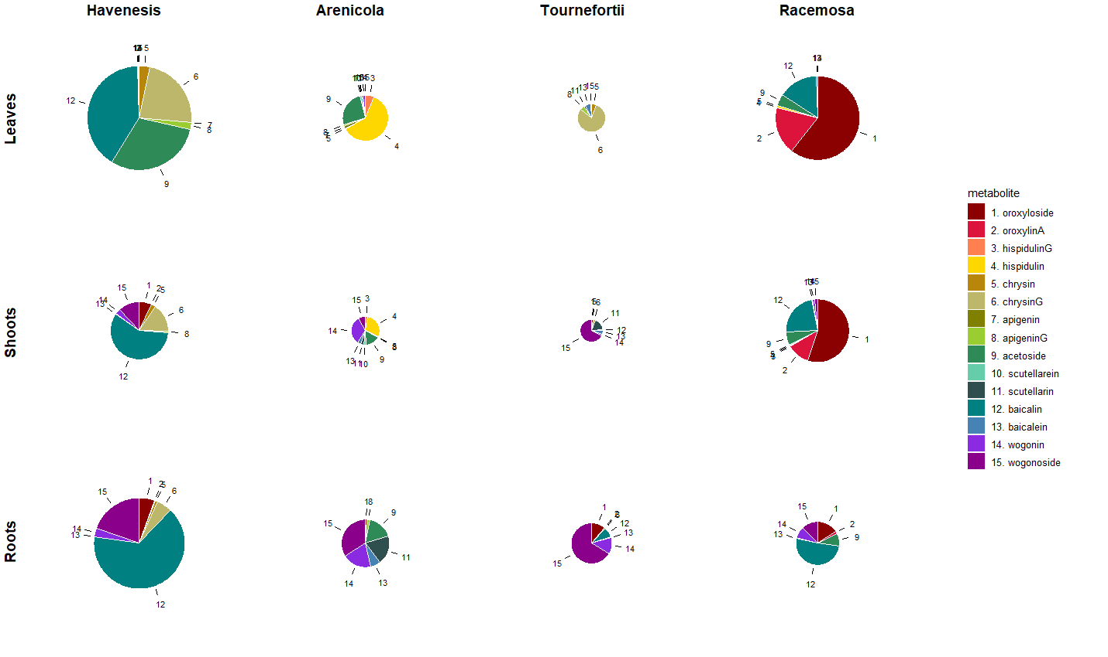
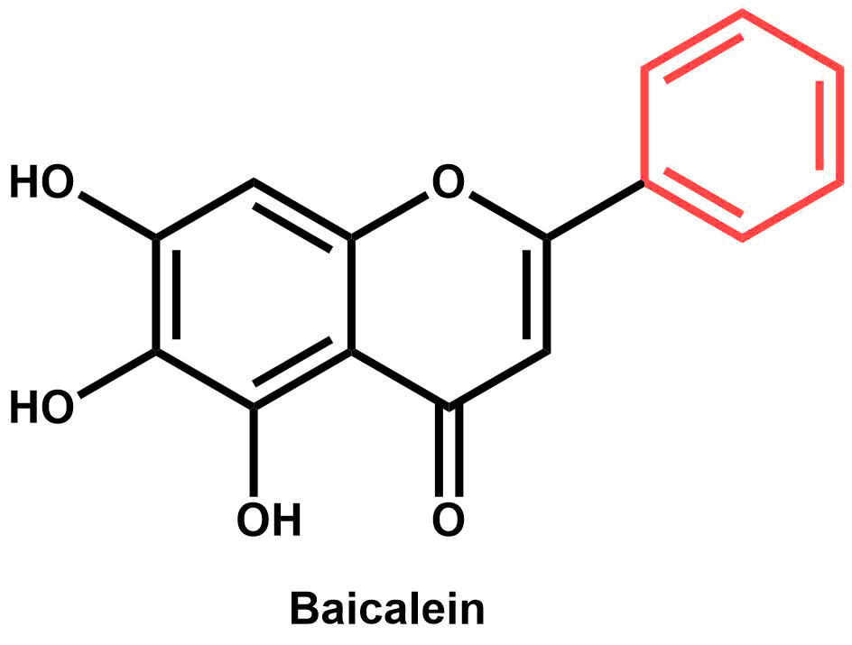
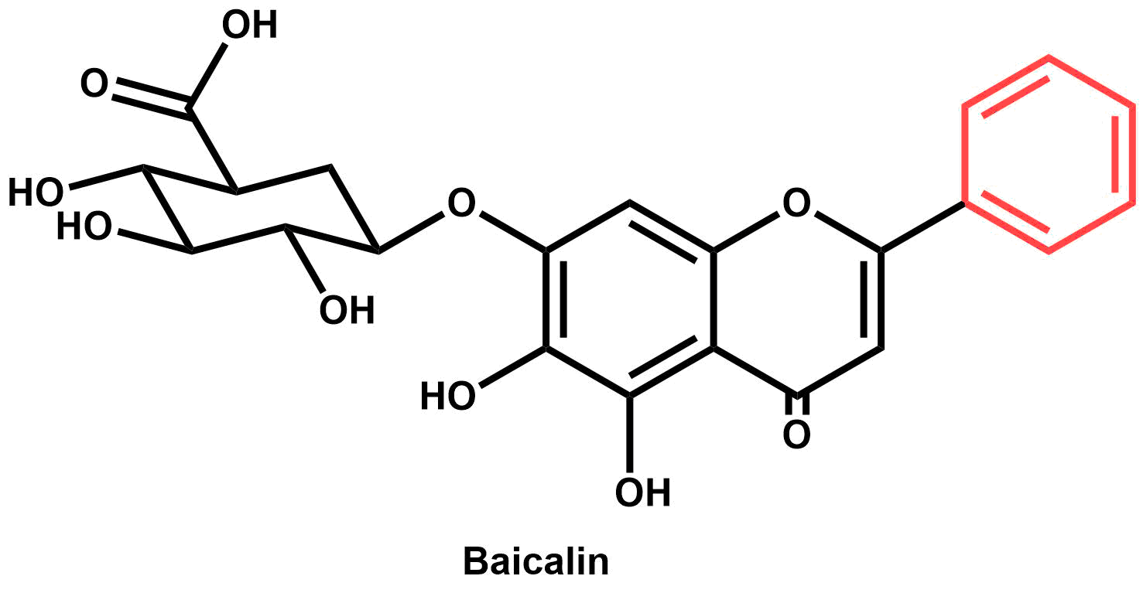
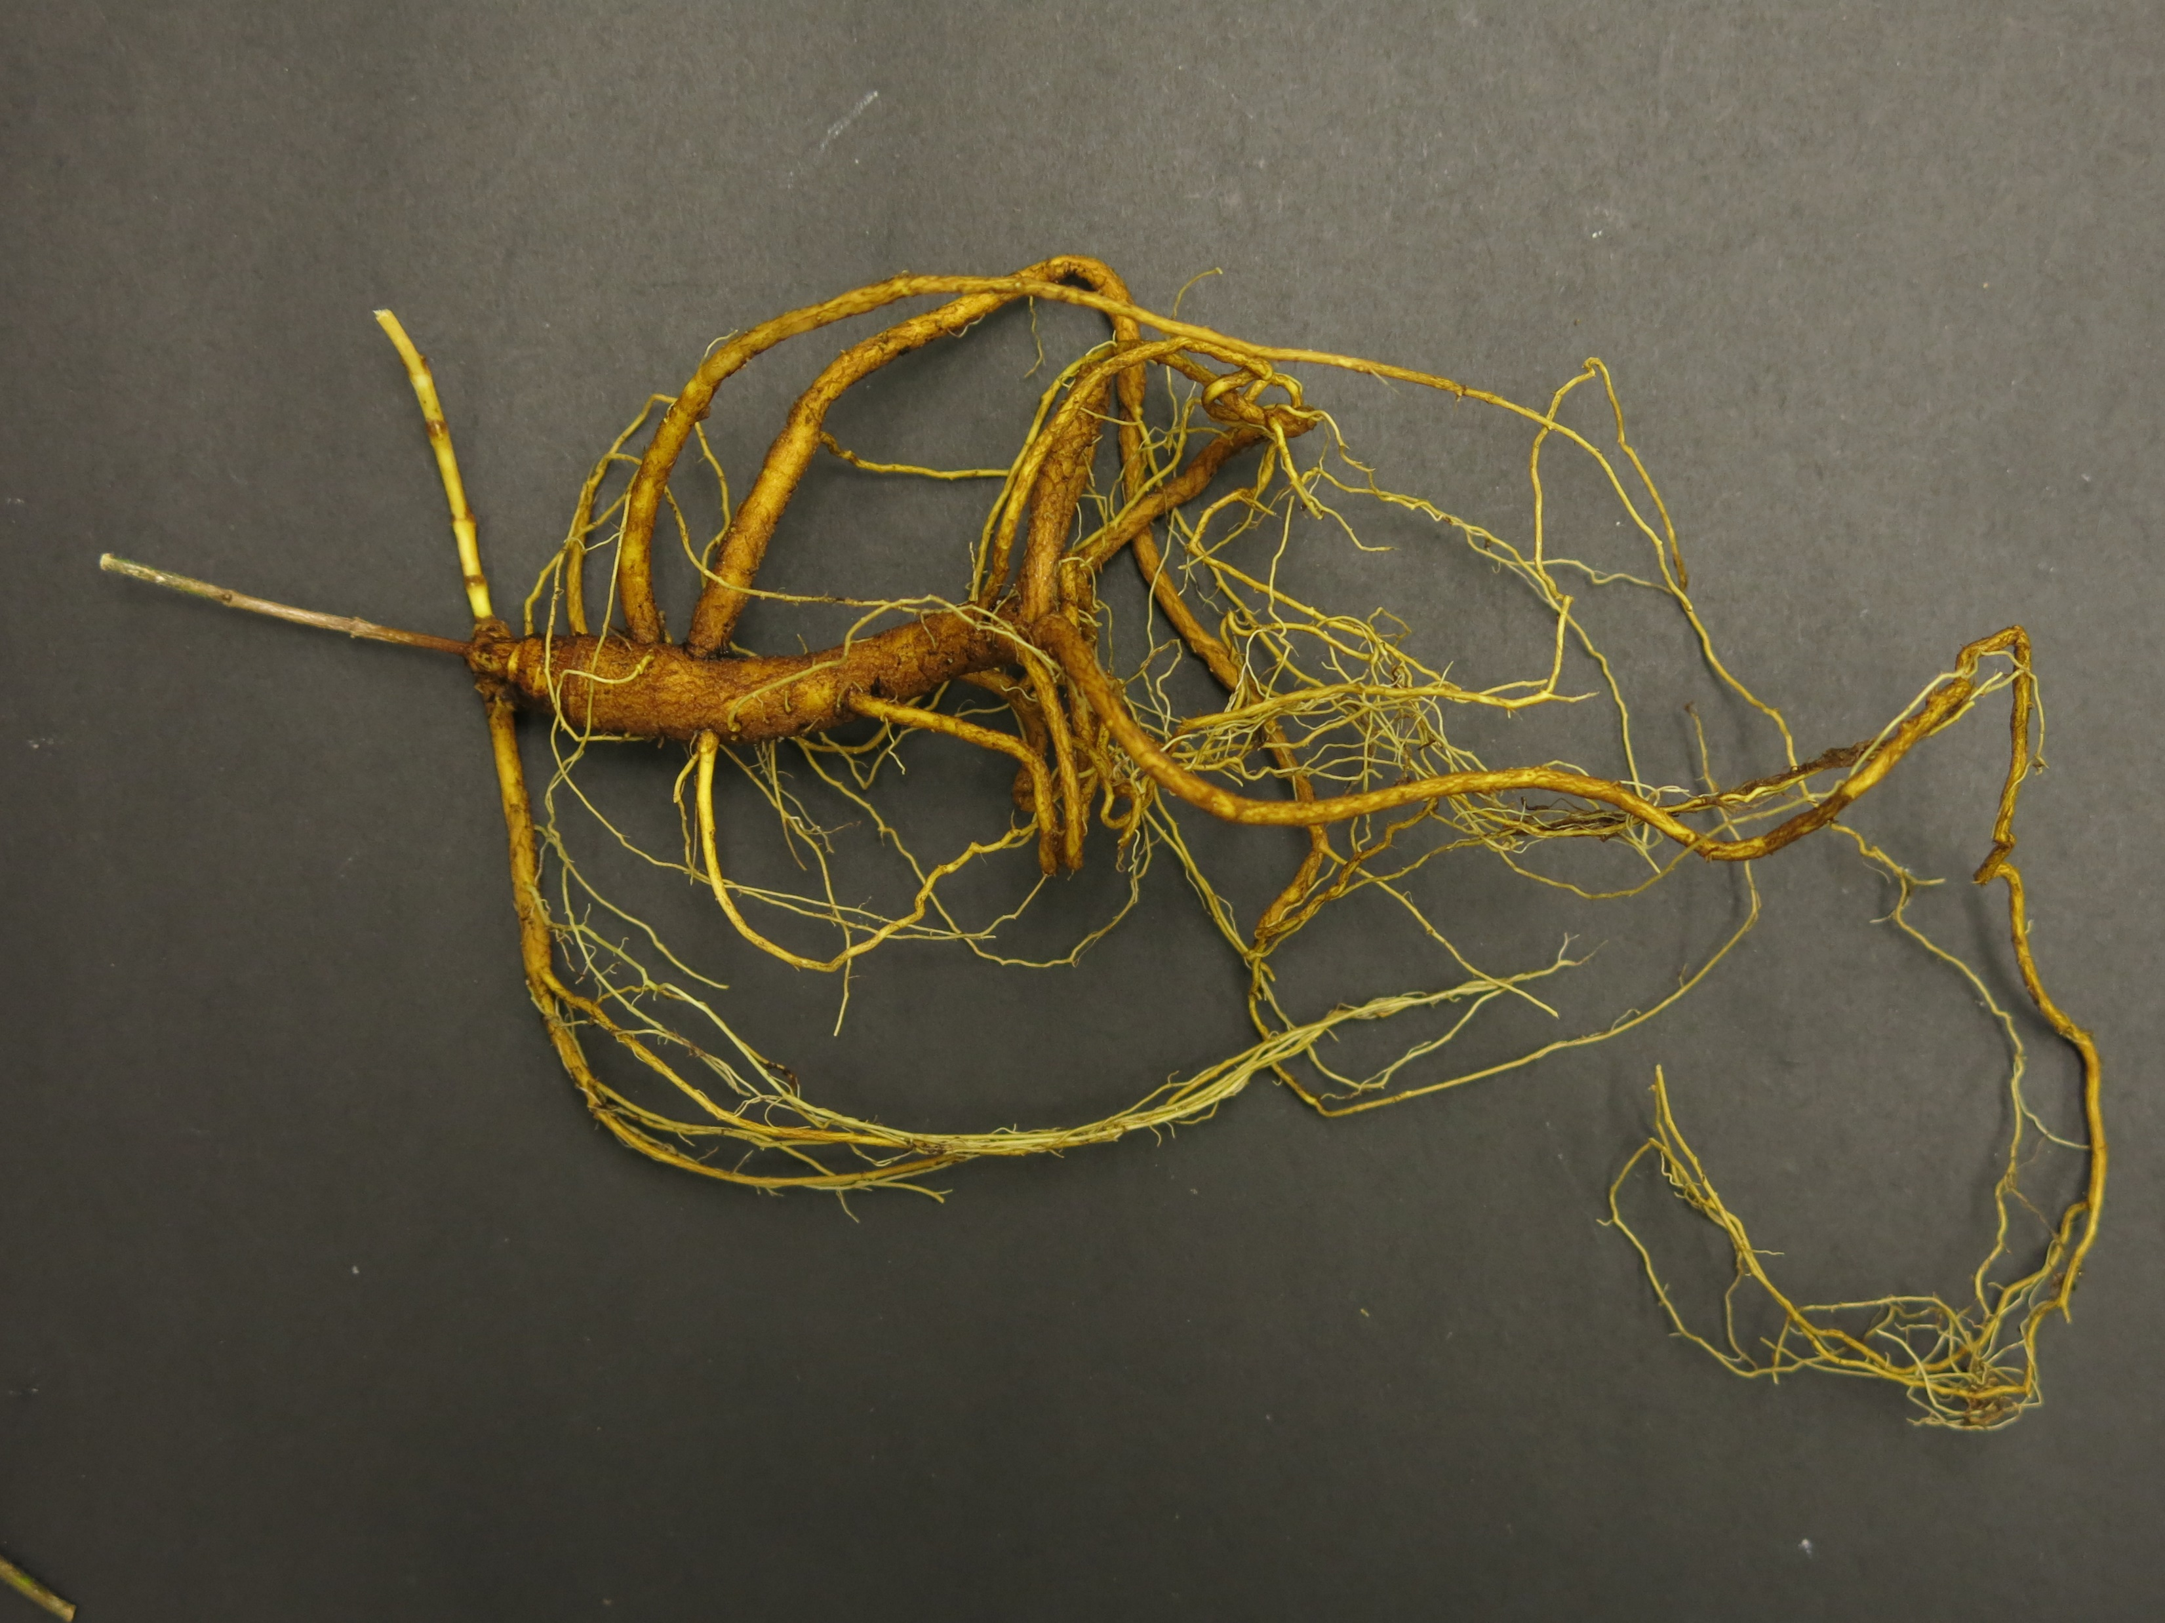
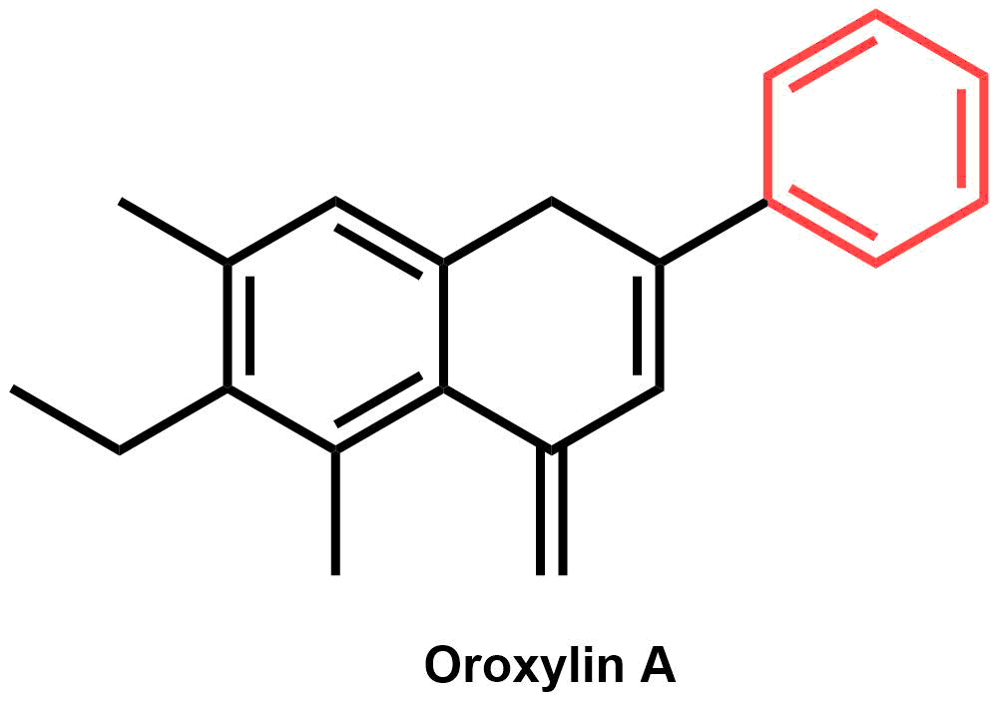
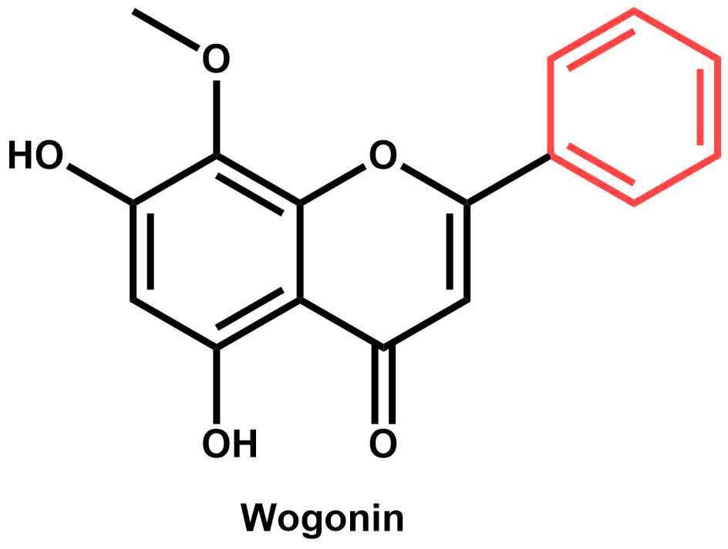
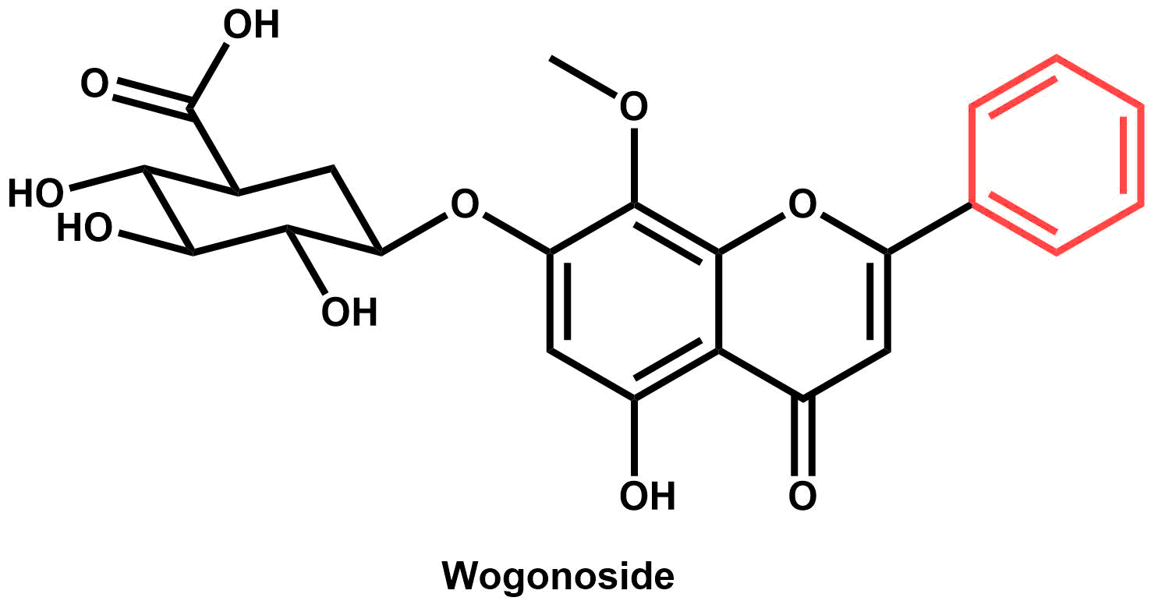

An investigation of flavonoid diversity in Scutellaria to identify species with medicinal potential
Bryce Askey, Yeong Hun Song, Yoonkyung Lee, Ru Dai, Sangtae Kim, and Jeongim Kim
Author affiliations
Methods and Results
High Performance Liquid Chromatography (HPLC) was used to perform targeted metabolite analysis on … species of Scutellaria.
Figure 3. Heatmap of herbarium samples + avg of organ-specific data
Figure 4. Phylogenetic tree
Genomic size for 8 species was estimated with flow cytometry
Abstract
Scutellaria baicalensis is a medicinal plant whose root extracts have been widely used in Asian medicine for more than 2,000 years. Although S. baicalensis has been well-studied, the majority of the 470 species in the Scutellaria genus have not been analyzed. This study aims to extend the current knowledge of Scutellaria by analyzing flavonoid profiles and genome sizes of a large set of species representing the diversity in the genus. Targeted metabolite analysis via High Performance Liquid Chromatography (HPLC) was used to quantify concentrations of 15 medicinally relevant flavones. The genome sizes of eight of the species analyzed were also estimated with flow cytometry. A comparison of phytochemical profiles indicate diversity in site and identity of accumulation for multiple species when compared to S. baicalensis. Inconsistences in site of accumulation imply significant differences in biosynthetic pathway exists for several species. Researchers studying Scutellaria can use the results of this work to identify previously uncharacterized species with medicinal potential, aiding in the development of new drugs and treatments.
Background
Root extracts of S. baicalensis have medicinal properties
Anti-cancer, anti-Alzheimer’s, …
S. baicalensis is well studied
Reference genome recently completed
Proposed biosynthesis pathway
Little is known about the 470 other species in the Scutellaria genus
Goal: Identify similarities and differences between organ-specific phytochemical profiles of a wide range of Scutellaria species
A.
B.
Table 1. Genome sizes for species of interest
C.
Figure 1. Morphological differences between (A) S. baicalensis, (B) S. lateriflora, and (C) S. racemosa plants.
Baicalein:
anti-Alzheimer’s and anxiolytic activity (Shang et al., 2005; Gasiorowski et al., 2011; Awad et al., 2003; Cole et al., 2007)
Baicalin:
anti-cancer and anxiolytic activity (Zhao et al., 2016;
Awad et al., 2003; Cole et al., 2007)
Oroxylin A:
anti-Alzheimer’s activity (Shang et al., 2005; Gasiorowski et al., 2011)
Figure 5. Scaled pie charts for organ-specific data
Conclusions
Discrepancies in proposed biosynthetic pathway for S. baicalensis and metabolite profiles for … imply …
Genome size is similar to S. baicalensis for 7 of the 8 species analyzed
Wogonin:
anti-cancer and anti-Alzheimer’s activity (Zhao et al., 2016; Cole et al., 2007
Wogonoside:
anti-cancer activity (Zhao et al., 2016)
References
Use colored dots to label medicinal properties, and create key
Underline headings with blue line
Acknowledgements
Figure 2. S. baicalensis root extracts contain a variety of metabolites with medicinal properties.

